Slide 1
Regenerative medicine and fertility preservation
Dr S.Arefi
Associated prof.
Avicenna Research center

Slide 2
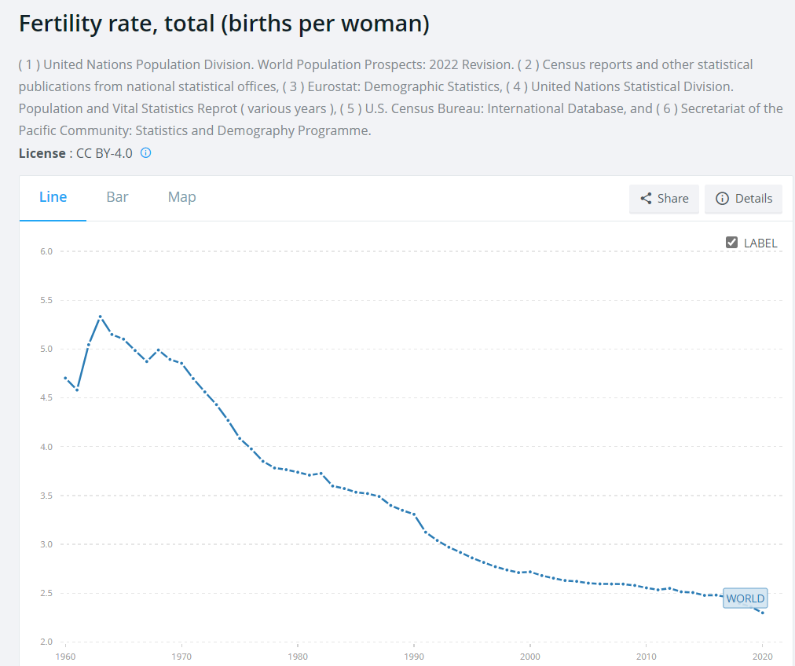

Slide 3
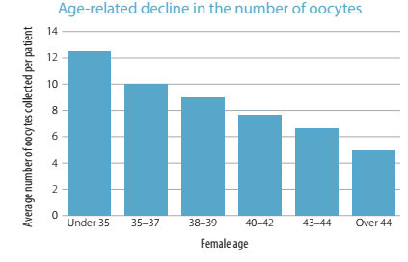

Slide 4
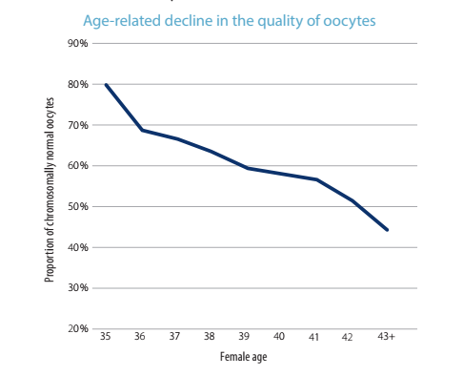

Slide 5
Substantial number of couples cannot conceive even after ART, except through gamete donation or adoption. Infertility due to gamete deficiency resulting from genetic defects does not benefit from ART. However, most couples seeking infertility treatment wish to have their own genetically related issues resolved . In this respect, regenerative medicine have shown new hope .

Slide 6
Regenerative medicine is focused on developing and applying new treatment to heal tissues and organs and restore function lost due to aging ,disease, damage or defects.

Slide 7
Stem cell and reproduction

Slide 8
Various preclinical and clinical studies have reported the potential therapeutic application of MSCs for the treatment of infertility due to ovarian and endometrial dysfunction.
Galipeau J., Cell Stem Cell. 2018

Slide 9
MSCs are defined as cells that have plastic-adhesion properties, express CD105, CD73 and CD90 as surface markers.
Depending on their origin, MSCs are categorized as bone marrow stromal cells, adipose-derived stem cells, menstrual-blood-derived MSCs and umbilical-cord-derived MSCs , amniotic-fluid-derived MSCs, placental-tissue-derived MSCs, salivary-gland-derived MSCs, and dental-pulp-derived MSCs
Zhao Y. -X, Stem Cells Int. 2019
Esfandyari S., Cells. 2020

Slide 10
Menstrual MSC
Endometrial stem cells are present in both the basalis and functional layers of the human endometrium, and it is thought that these stem cells play a role in regenerating the endometrial lining during each estrous cycle.

Slide 11
Menstrual Blood Mesenchymal Stem Cell (MB-MSC)
Menstrual-blood-derived MSCs (MB-MSCs) have the potential to proliferate and differentiate into multiple lineages and can self-renew similar to other stem cells. Moreover, the collection of these cells is noninvasive, safe, and easy, without ethical issues and with minimal immune reactions, facilitating their clinical application in reproductive medicine compared to other tissue-derived stem cells.

Slide 12
Liu et al. have shown that MB-MSC treated groups of animals showed an increase in the number of the normal ovarian follicles and restoration of normal ovarian function represented by a higher level of ovarian hormones compared to control.
Liu T. Stem Cells Dev. 2014
MB-MSC improved ovarian function through localization of MSCs into granulosa cells and by augmentation of the expression of FSH receptors as well as restoration of hormone levels .
Manshadi. Microsc. Res. Tech. 2019

Slide 13
Improvement of Pregnancy Rate and Live Birth Rate in Poor Ovarian Responders by Intraovarian Administration of Autologous Menstrual Blood Derived- Mesenchymal Stromal Cells: Phase I/II Clinical Trial
POR women were divided into mesenchymal stroma cell (MSC) therapy (n = 15) and routine ICSI (n = 16) groups. The cultured Men-MSCs were autologously injected into left ovary of MSC group after approval by flow cytometry, karyotyping, endotoxin, sterility and mycoplasma tests. Changes in anti-Mullerian hormone (AMH), antral follicles count (AFC), oocytes and embryos number, clinical pregnancy rate and live birth rate were followed in both groups up to one year after treatment. 4 of 15 participants in MSC group got naturally pregnant during 3 months after cell administration, in contrast to no natural conception in control group (P = 0.04). The mean AMH level and mean AFC and oocytes number did not significantly differ with that of previous cycle or control group. Nonetheless, oocyte fertilization rate and embryo number in MSC group were higher than control group (P = 0.04 and P = 0.008, respectively). Altogether, 7 of 15 women in MSC group and 2 of 16 women in routine ICSI group had clinical pregnancy that resulted in 5 live births in main group and one birth in control group. In conclusion, cell therapy using Men-MSCs could be considered as a potential treatment to restore fertility capability of POR women.
Simin Zafardoust et al ,2020

Slide 14
مطالعه فاز یک و دو

Slide 15
group | Stem cell(n=11) |  |  | Control(n=16)
Therapy situation parameter | before | after | P value | before | after | P value*
AMH | 0.4(0.6) | 0.5(0.9) | 0.14 | 0.6(0.7) | 0.4(0.5) | 0.008
AFC (right ovary) | 1(2) | 3(2) | 0.01 | 2(2) | 2(2) | 0.15
AFC (left ovary) | 1(2) | 2(3) | 0.11 | 1(1) | 1(1) | 0.55
Gonadotropin Ampoules number | 59(34) | 50(18) | 0.30 | 60(8) | 64(21) | 0.22
Duration of HMG administration(days) | 8(3) | 10(3) | 0.92 | 10(2) | 10(4) | 0.06
Number of follicles | 2(4) | 4(6) | 0.01 | 3(4) | 4(1) | 0.71
Number of oocytes | 1(2) | 3(5) | 0.01 | 2(3) | 1(1) | 0.71
Fertilization rate (%) | 75%,80% | 90%,94% | 0.01 | 80%,85% | 60%,63% | 0.27
Number of embryos | 0(2) | 3(5) | 0.01 | 1(3) | 1(1) | 0.20
Number of embryos (Grade A) | 0(0) | 2(5) | 0.01 | 1(2) | 0(1) | 0.03

Slide 16
Group parameter | Stem cell group(n=15) | Control group(n=15) | P-value
Spontaneous clinical pregnancy | 4(26.7%) | 0(0%) | 0.032
Spontaneous live birth | 3(20%) | 0(0%) | 0.068
Total Clinical pregnancy rate | 7 (46.7%) | 2(13.3%) | 0.04
Total live birth rate | 5 (33.3%) | 1(6.7%) | 0.06
Sex of born babies | 3 boys and 2 girls | 1 girl | -
Babies weight | 3200-3950g | 3320 g | -

Slide 17
مطالعه فاز 3

Slide 18
Hormone Levels in Each Group after 2-4 Months
In >40years old group |  |  | In ≤40years old group
P-value | Control over 40y (n=39) | MSC over 40y (n=44) | P-value | Control ≤ 40y (n=44) | MSC ≤ 40y (n=44)
0.013 | 0.32±0.3 | 0.56±0.5 | <0.001 | 0.26±0.22 | 0.85±0.68 | AMH after 2 months
0.70 | 16±7.2 | 17.2±17.5 | <0.001 | 15.4±7.2 | 9.6±6.4 | FSH after 2 months
<0.001 | 2.2±1 | 4.2±2.2 | <0.001 | 1.7±1 | 5.3±2.6 | AFC after 2 months
0.15 | 0.2±0.3 | 0.4±0.3 | 0.003 | 0.25±0.3 | 1.1±1 | AMH after 4 months
0.35 | 18.4±8.5 | 15.1±15.4 | <0.001 | 18±5 | 11±5.4 | FSH after 4 months
0.002 | 0.5±1.1 | 1.6±1.5 | <0.001 | 1±1 | 4.2±2.7 | Number of oocytes
<0.001 | 0.4±0.9 | 1.3±1.3 | <0.001 | 0.7±0.9 | 3.1±2 | Number of MII oocytes
<0.001 | 0.3±0.5 | 1.2±1.3 | <0.001 | 0.4±0.6 | 2.4±1.7 | Number of embryos
<0.0001 | 0.05±0.2 | 0.8±1.2 | <0.001 | 0.1±0.3 | 1.8±1.6 | Number of high quality embryos

Slide 19
بارداری در بیماران زیر 40 سال در دو گروه سلول و کنترل
P-value | Control ≤ 40y | MSC ≤ 40y
0.003 | 2(4.5%) | 12(27.3%) | Spontaneous Pregnancy
0.009 | 2(4.8%) | 8(27.6%) | Pregnancy after ICSI
0.00 | 4(9.1%) | 20(50%) | Total Pregnancy
0.00 | 4(9.1%) | 20(50%) | Implantation
0.00 | 3(6.8%) | 17(42.5%) | Clinical Pregnancy
0.02 | 3(6.8%) | 11(27.5%) | Live birth rate

Slide 20
بارداری در بیماران بالای 40 سال در دو گروه سلول و کنترل
P-value | Control over 40y | MSC over 40y
0.175 | 2(5.1%) | 6(13.6%) | Spontaneous Pregnancy
0.26 | 2(5.6%) | 0(0%) | Pregnancy after ICSI
0.38 | 4(10.8%) | 6(15.8%) | Total Pregnancy
0.38 | 4(10.8%) | 6(15.8%) | Implantation
0.38 | 4(10.8%) | 6(15.8%) | Clinical Pregnancy
0.21 | 2(5.4%) | 5(13.5%) | Live birth rate

Slide 21
It was documented that MSC derived from menstrual blood could resume fertility in an animal model of damaged endometrium through induction of angiogenesis and release of anti-inflammatory factors.
Domnina A. Stem Cell Res. Ther. 2018

Slide 22
Zheng et al. documented for the first time a theoretical basis of the use of MB-MSCs for the treatment of intrauterine adhesion. MB-MSCs could differentiate into endometrial cells in vitro, and subsequent transplantation in vivo to NOD-SCID mice resulted in regeneration of endometrium.
Zheng S.X., Int. J. Mol. Med. 2018
MB-MSCs along with platelet-rich plasma could efficiently induce resumption of fertility in a mechanical injury-induced rat model of intrauterine adhesion through significant modulation of the Hippo signalling pathway and its downstream regulators.
Zhang S., Stem Cell Res. Ther. 2019

Slide 23
Recent research
Improvement of pregnancy rate and endometrial thickness by
Stem cell therapy in patients with thin endometrium.
S.Arefi, S.Kazemnejad et al

Slide 24
Stem cells are now increasingly being investigated as promising alternative therapeutics in translational research of regenerative medicine.

Slide 25
Thank you

